Slide 1
vermicomposting

Slide 2

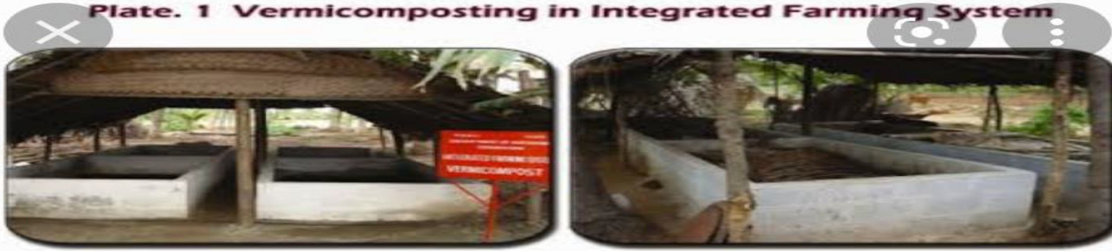
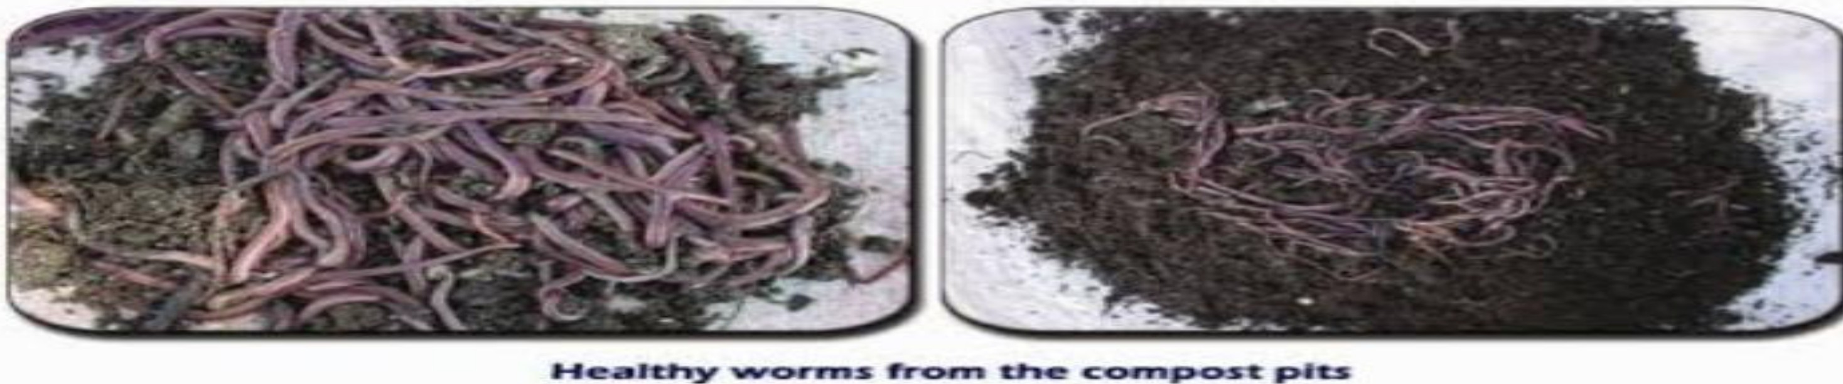
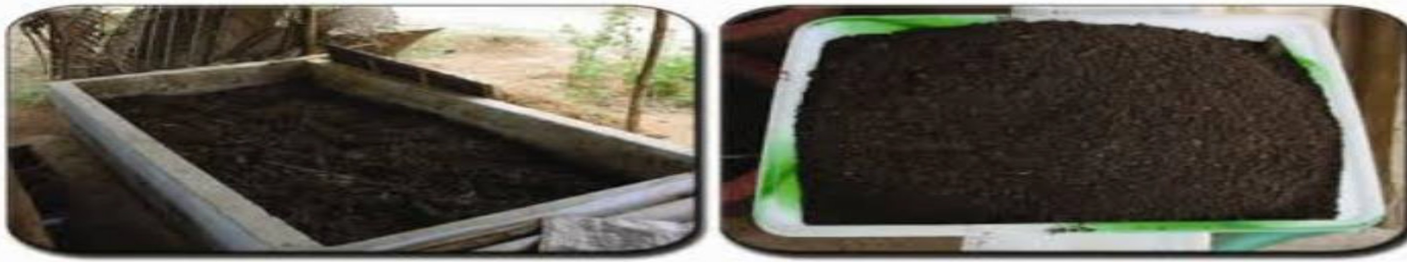
5:35P
��
I
{ 78 )ll
.n^{4G}.. tl

Slide 3
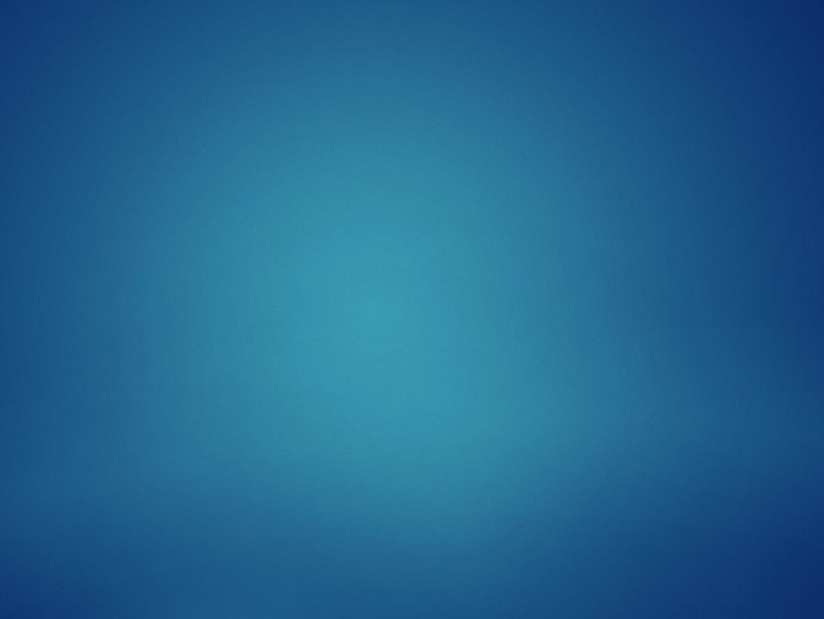






What is vermicomposting
Vermicomposting is a process in which the earthworm converts the inorganic waste into manure rich in high nutritional content .

Slide 4
Vermicomposting
It is the scientific method of making compost ,by using earthworms .They are commonly found living in soil, feeding in a biomass and excreting it in a digestive form that is vermicompost
.

Slide 5
what is vermicasts?
It is the end product of the breakdown of organic matter by earthworms .These castings have been shown to contain reduced level of contaminants and a higher saturation of nutrients than the organic materials before vermicomposting . That are rich in nitrates and minerals such as phosphorus
,magnesium,calcium and potassium .
These are use as fertilizers and enhance
soil quality.

Slide 6
BED METHOD- this is an easy method in whick
beds of organic matter are prepared.
PIT METHOD- in this methods ,organic matters are collected in cemented pits.However this method is not prominent as it Involves problems of aeration and water logging.

Slide 7
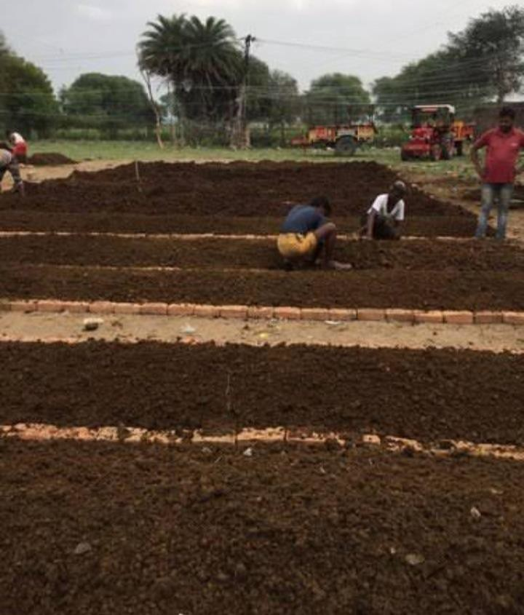

Slide 8

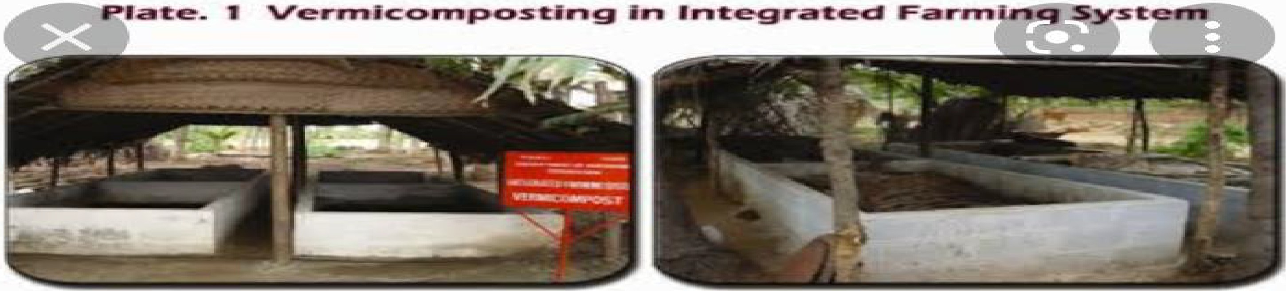
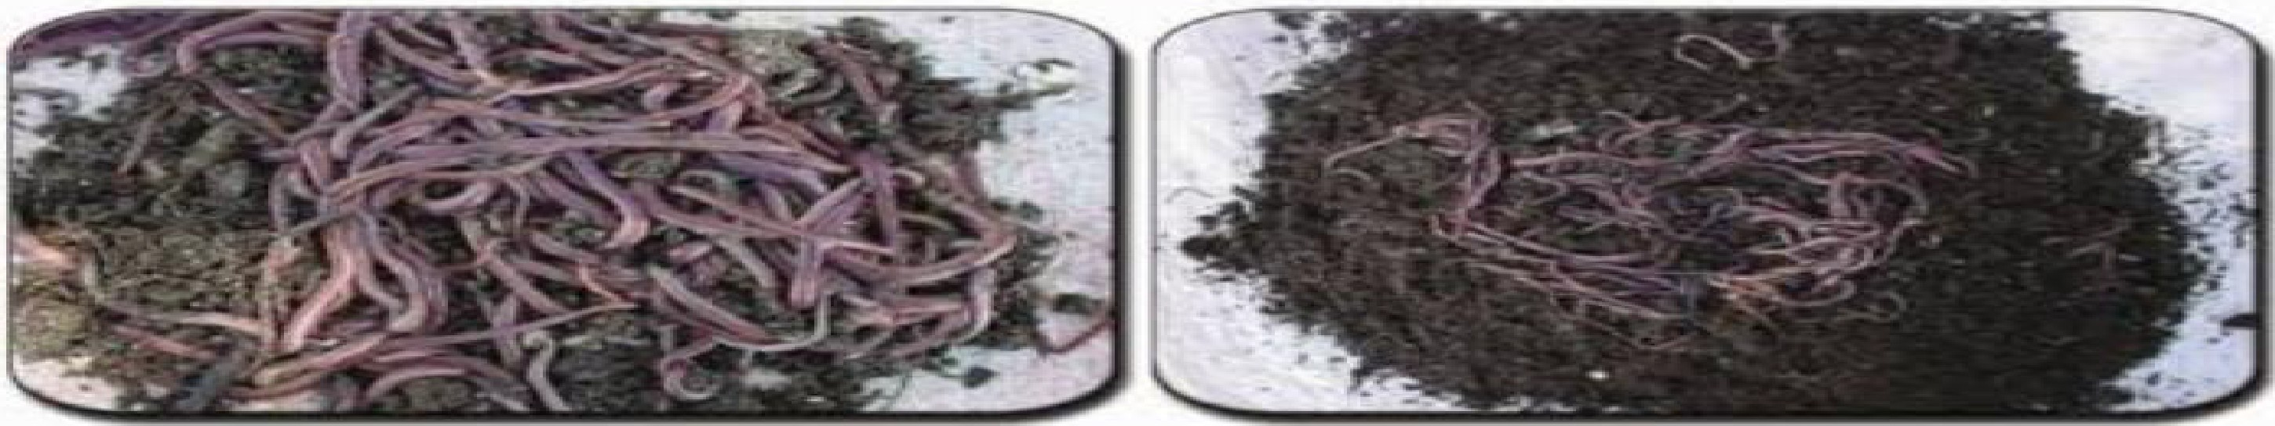
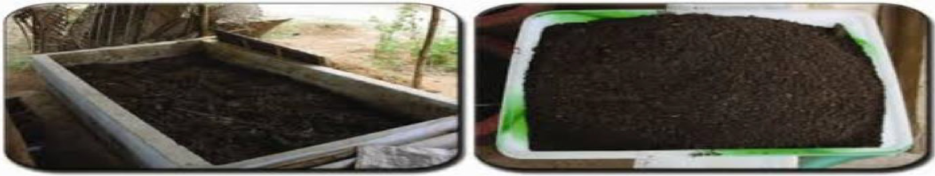

5:35 PM _ei�

Slide 9
Process of
vermicomposting ……..
▶Aim-
To prepare
vermicompost using earthworms and other biodegradable wastes.
▶Principle –Theis process is mainly required to add nutrients to the soil . Compost is a natural fertilizer that allows an easy flow of water to the growing plants .

Slide 10







NUTRIENTS OF
VERMICOMPOSTS ARE…….
▶ 1.6 % of nitrogen.
▶ 0.7% of phosphorus .
▶ 0.8% of potassium .
▶ 0.5% of calcium.
▶ 0.2% of magnesium.

Slide 11
MATERIALS REQUIRED…..
▶ Water
▶ Cow dung
▶ Thatch roof
▶ Soil or sand
▶ Gunny bags
▶ Earthworms
▶ Weed biomass
▶ A large bin
▶ Dry leaves collected from paddy fields
▶ Biodegradable wastes collected from field and kitchens

Slide 12
PROCEDURE…
To prepare composts ,either a plastic or a concrete tank can be used .The size of the tank depends upon availability of the raw material .
Collect the biomass and place it under the sun for about 8-12 days. Now it to the required size using the cutter .
Prepare a cow dung slurry and sprinkle it on a heap for quick decomposition .
Add a layer 2-3 inch of soil at the bottom of the
tank.

Slide 13
Now prepare fine bedding by adding partially decomposed cow dung , dried leaves and other biodegradable wastes collected from fields and kitchen . Distribute them evenly on the sand layer.
Continue adding both the chopped biowastes and partially decomposed cow dung layer wise in the tank .
And add all the wastes of earthworm and cover it with the gunny bags .
Sprinkle water on the regular basis to maintain the moisture .

Slide 14
▶ Cover the tank with the thatch roof to prevent
the entry of ants, lizards,mouse,snakes etc.
▶ Protect the compost from rain water and direct sunshine .
▶ Have a frequent check to avoid over heating .
Maintain proper moisture and temperature.

Slide 15
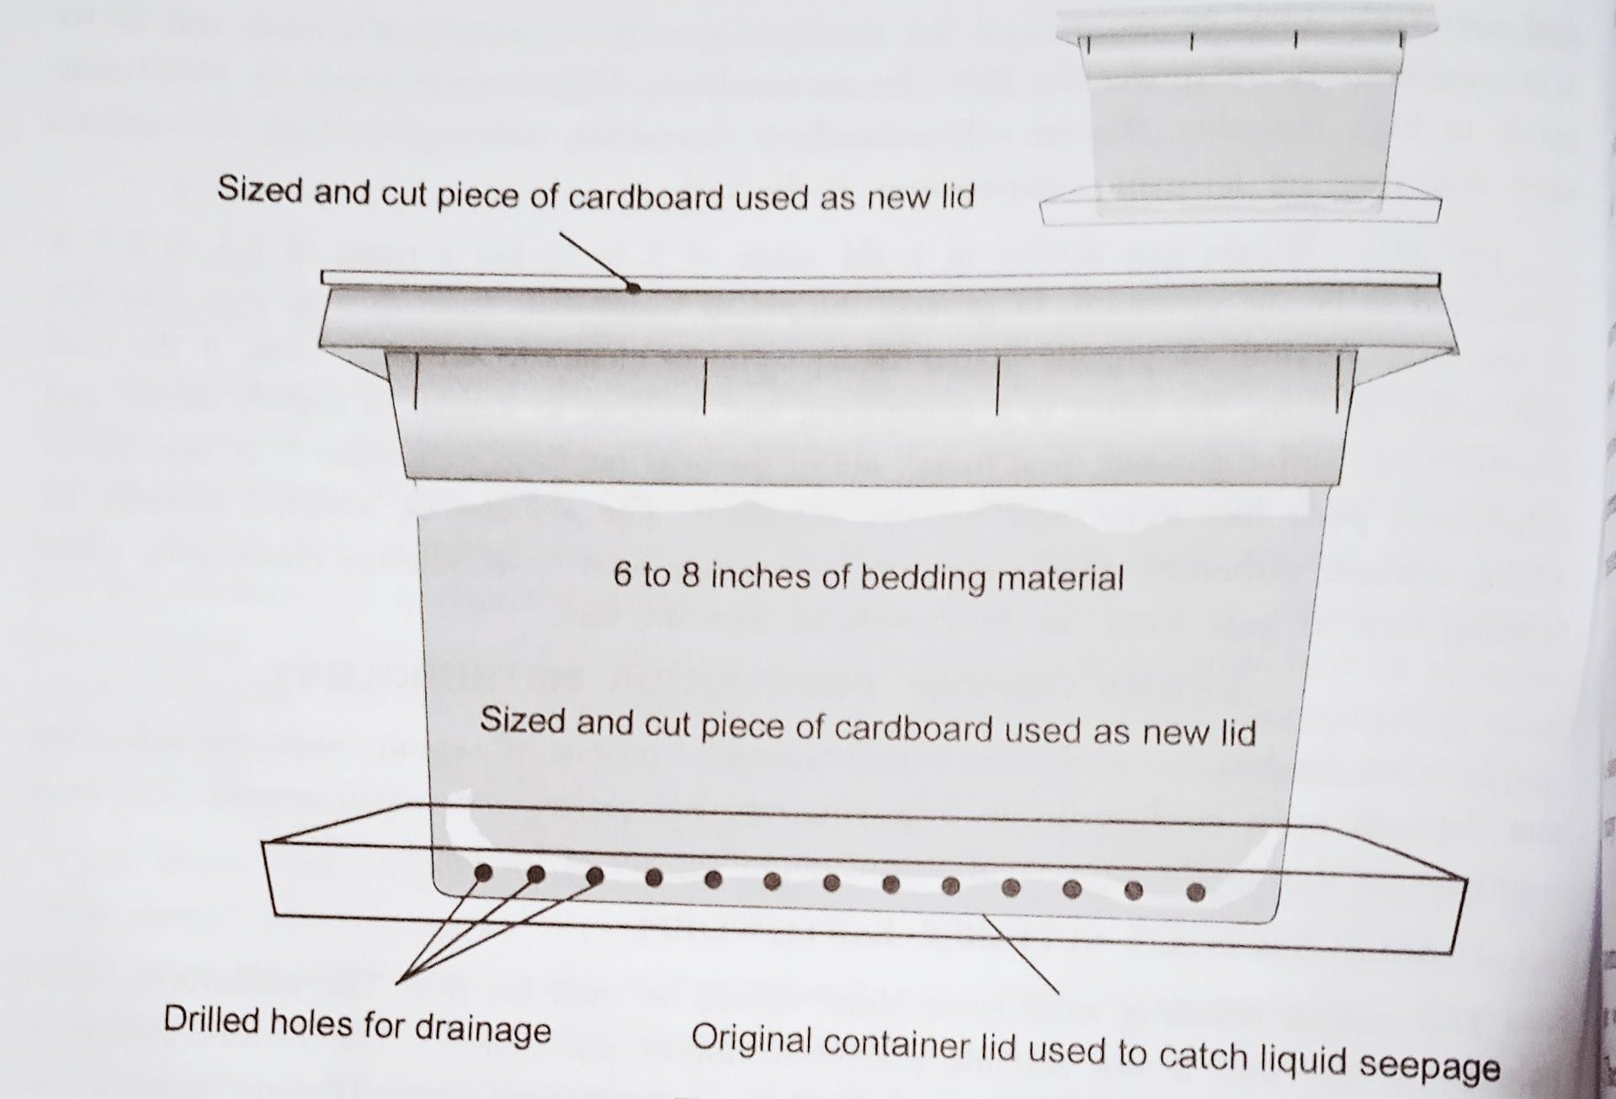

Slide 16
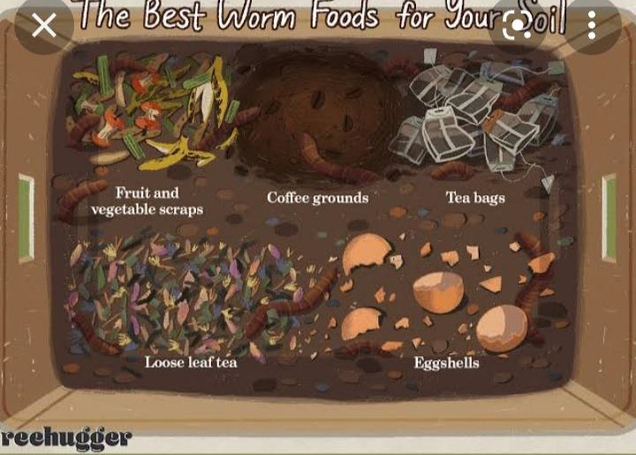

Slide 17
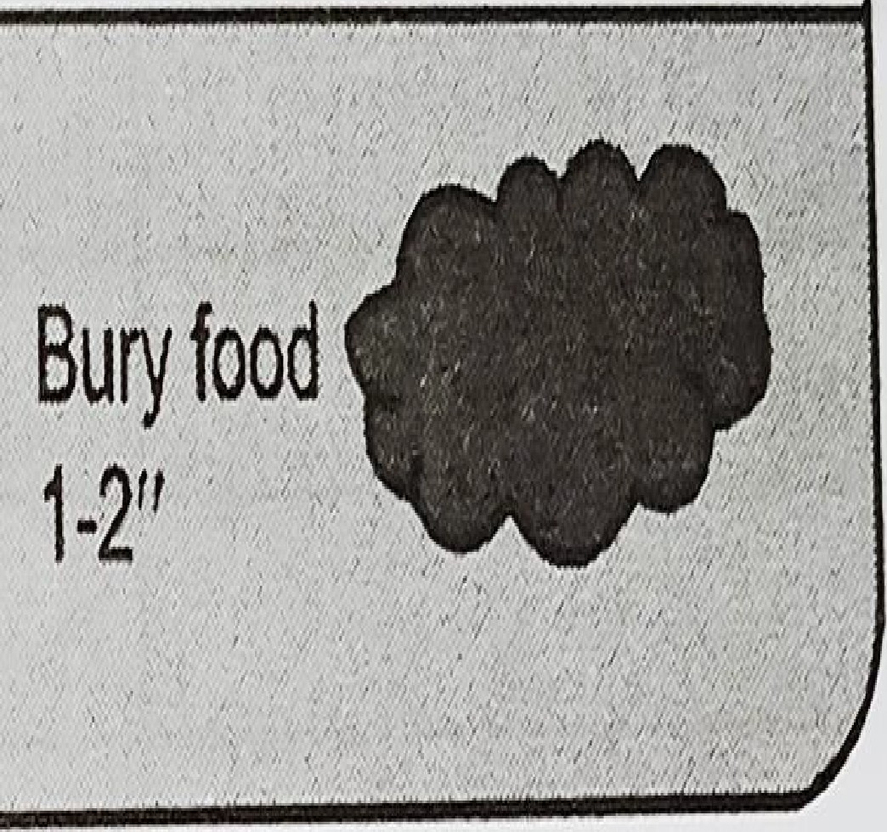
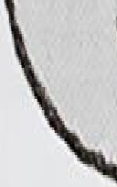
8-12''
 | 0 0 0 0 0 0 0 Air holes/
 | Min. 4-6" bedding
Fig.125. Vermiculturebed

Slide 18
RESULTS…….
▶ After the 24th day , about 4000 to 5000 new worms are introduced and entire raw material is turned into vermicompost .

Slide 19
Advantages …….
▶ Develop roots of the plants.
▶ Improve the physical structure of the soil.
▶ Increase the fertility and water resistance of the soil .
▶ Help in germination , plant growth and crop
yield .
▶ Soil with plant growth hormones such as auxins and gibberellic acid etc .
▶ Also refer vermiculture.

Slide 20
Disadvantages……
▶ It is a time consuming process .
▶ It release a very foul odour .
▶ Care should be taken very carefully .
▶ The bin should not be too dry or too wet . The moisture levels should be monitored periodically .
▶ They nurture the growth of the pests and pathogens such as fruit fles and centipede and flies .

Slide 21
THANK YOU……

